Slide 1
Analysis of Algorithm and Design
Lecture 1

Slide 2
Acknowledgement
This lecture note has been summarized from lecture note on Data Structure and Algorithm, Design and Analysis of Computer Algorithm all over the world. I can’t remember where those slide come from. However, I’d like to thank all professors who create such a good work on those lecture notes. Without those lectures, this slide can’t be finished.
Analysis of Algorithm

Slide 3
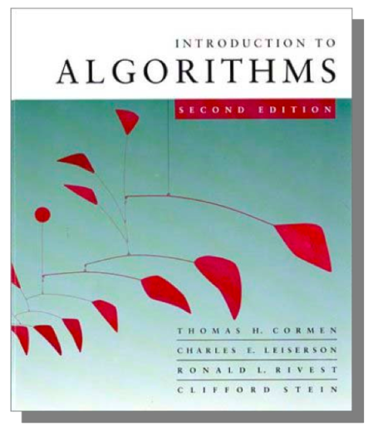
More Information
Textbook
  Introduction to Algorithms 2nd ,Cormen,
  Leiserson, Rivest and Stein, The MIT Press, 2001.
  Data Structures and Algorithm Analysis
Clifford A. Shaffer,Edition 3.2 (C++ Version),2012.
Others
  Introduction to Design & Analysis Computer Algorithm 3rd, Sara Baase, Allen Van Gelder, Adison-Wesley, 2000.
  Algorithms, Richard Johnsonbaugh, Marcus Schaefer, Prentice Hall, 2004.
  Introduction to The Design and Analysis of Algorithms 2nd Edition, Anany Levitin, Adison-Wesley, 2007.
Analysis of Algorithm

Slide 4
Course Objectives
This course introduces students to the analysis and design of computer algorithms. Upon completion of this course, students will be able to do the following:
  Analyze the asymptotic performance of algorithms.
  Demonstrate a familiarity with major algorithms and data structures.
  Apply important algorithmic design paradigms and methods of analysis.
  Synthesize efficient algorithms in common engineering design situations.
Analysis of Algorithm

Slide 5

Objective of course
In this course we will cover the following topics:
Understand foundations of algorithms && design and analysis various variants algorithms
Accuracy
Efficiency
Comparing efficiencies
Make use of skills to understand mathematical notations in algorithms and their simple mathematical proofs
Gain familiarity with a number of classical problems that occur frequently in real-world applications
Analysis of Algorithm

Slide 6
Advanced Algo Analysis
COURSE OUTLINE
Preliminaries : different types of algorithms, analyzing methodologies,
notations, proof techniques and limits.
Asymptotic Notation : different notations and their examples, standard
notations and their common functions.
Analysis of Algorithms : analyzing control structures, using barometer
instruction, amortization, and different examples for analysis and solving
recurrences.
Structures: use of arrays, stacks, queues, records, pointers, lists, graphs,
trees, hash tables, heaps and binomial heaps.
Searching/Sorting Algorithms : Various searching and sorting algorithms and
their comparisons.
Analysis of Algorithm

Slide 7
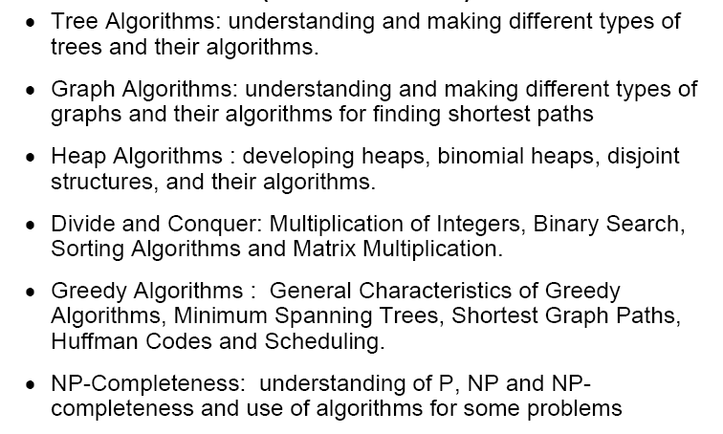
Advanced Algo Analysis
COURSE OUTLINE
Analysis of Algorithm

Slide 8
What is Algorithm?
Algorithm
  is any well-defined computational procedure that takes some value, or set of values, as input and produces some value, or set of values, as output.
  is thus a sequence of computational steps that transform the input into the output.
  is a tool for solving a well - specified computational problem.
  Any special method of solving a certain kind of problem (Webster Dictionary)
Analysis of Algorithm

Slide 9
What is the specification of algorithm?
We can specify an algorithm by 3 types:
1. Using Natural language
2. Pseudocode;
3. And flowchart.
Natural language is general way to solve any problem
For e.g to perform addition of two numbers we write in natural language
Step1: read the first number (assume a)
Step2:read the second number (assume b)
Step3:add 2 numbers(a and b)and store the result in a variable c
Step4:display the result
Analysis of Algorithm

Slide 10
Pseudocode
Combination of natural language and programming language construct For e.g.to perform addition of two numbers we write in pseudo-code
//this algo perform addition of two integers
//input two integers a and b
// output of two integers
C=a+b
Write c
Analysis of Algorithm

Slide 11
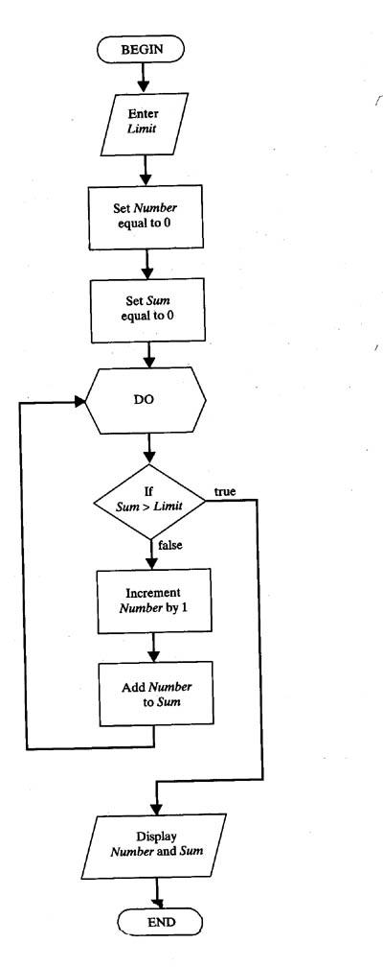
Another way to represent an algo is Flow chart .
Analysis of Algorithm

Slide 12
ALGORITHMICS
It is the science that lets designers study
and evaluate the effect of algorithms
based on various factors so that the best
algorithm is selected to meet a particular
task in given circumstances. It is also the
science that tells how to design a new
algorithm for a particular job.
Analysis of Algorithm

Slide 13

What is a program?
A program is the expression of an algorithm in a programming language
a set of instructions which the computer will follow to solve a problem
Analysis of Algorithm

Slide 14
Analysis of an Algorithm
What is analysis of an algorithm?
Ans. Algorithm analysis is an important part of a computational complexity theory.
There two types of analysis:
1.priori
2.posteriory
Analysis of Algorithm

Slide 15
Analysis of an Algorithm
Priori Analysis is the theoretical estimation of resources required.
On the other hand posterior Analysis done after implement the algorithm on a target machine.
Analysis of Algorithm

Slide 16
Introduction
Why need algorithm analysis ?
  writing a working program is not good enough
  The program may be inefficient!
  If the program is run on a large data set, then the running time becomes an issue
Analysis of Algorithm

Slide 17
Complexity of an algorithm
What is the complexity of an algorithm?
Complexity (or efficiency) of an algorithm is a function that describes the efficiency of an algorithm in terms of time and space.
There are two types of complexity:
1.Time complexity:
Time complexity means the amount of time required by an algorithm to run.
It expressed as an order of magnitude / degree
Analysis of Algorithm

Slide 18
2.space complexity:
Space complexity means the amount of space required by an algorithm to run.It expressed as an order of magnitude.There are two important factors to compute the space complexity:constant and instant characterstic.
e.g
factorial(n)
if n=0 then
return 1;
else
return*factorial(n-1);
endif
space complexity of program = constant size + variable size
Analysis of Algorithm

Slide 19
Types of Algorithms
Analysis of Algorithm

Slide 20
PROBABILISITIC ALGORITHM
In this algorithm, chosen values are used
in such a way that the probability of chosen each value is known and controlled.
e.g. Randomize Quick Sort
Analysis of Algorithm

Slide 21
HEURISTIC ALGORITHM
This type of algorithm is based largely on optimism and often with minimal theoretical support. Here error can not be controlled but may be estimated how large it is.
Analysis of Algorithm
Notes:
Heuristic meaning : encouraging a person to learn, discover, understand, or solve problems on his or her own, as by experimenting, evaluating possible answers or solutions, or by trial and error: a heuristic teaching method.

Slide 22
APPROXIMATE ALGORITHM
In this algorithm, answer is obtained that is as précised as required in decimal notation. In other words it specifies the error we are willing to accept.
For example, two figures accuracy or 8 figures or whatever is required.
Analysis of Algorithm

Slide 23
Things to do……
Learn general approaches to algorithm design
  Divide and conquer
  Greedy method
  Dynamic Programming
  Basic Search and Traversal Technique
  Graph Theory
  Linear Programming
  Approximation Algorithm
  NP Problem
Analysis of Algorithm

Slide 24
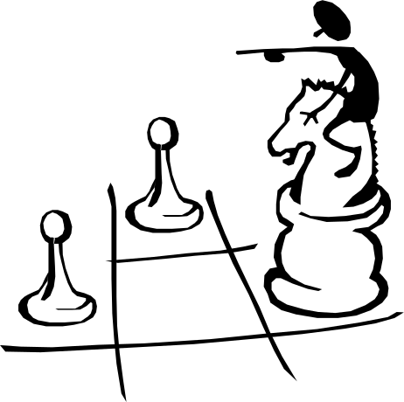
Some Application
Study problems these techniques can be applied to
  sorting
  data retrieval
  network routing
  Games
  etc
Analysis of Algorithm

Slide 25
What do we analyze about them?
Correctness
  Does the input/output relation match algorithm requirement?
Amount of work done (aka complexity)
  Basic operations to do task finite amount of time
Amount of space used
  Memory used
Analysis of Algorithm

Slide 26
Strengthening the Informal Definition
Important Features:
  Finiteness.[algo should end in finite amount of steps]
  Definiteness.[each instruction should be clear]
  Input.[valid input clearly specified ]
  Output.[single/multiple valid output]
  Effectiveness.[ steps are sufficiently simple and basic]
Analysis of Algorithm

Slide 27
performance analysis
What is performance analysis?
Performance analysis is the criteria for judging the algorithm.It have direct relationship to performance.When we solve a problem ,there may be more then one algorithm to solve a problem,through analysis we find the run time of an algorithms and we choose the best algorithm which takes lesser run time.
Analysis of Algorithm

Slide 28
Example Of Algorithm

Slide 29
Few Classical Examples
Classical Multiplication Algorithms
English
American
A la russe
Divide and Conquer
Analysis of Algorithm

Slide 30
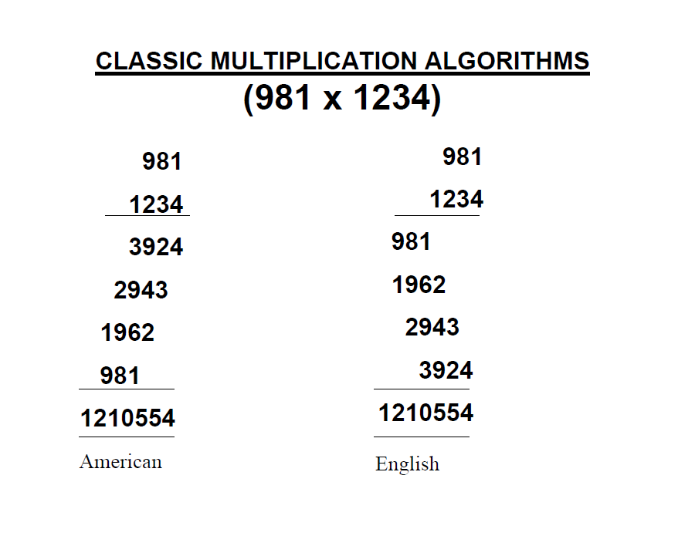
Classic Multiplication
Analysis of Algorithm

Slide 31
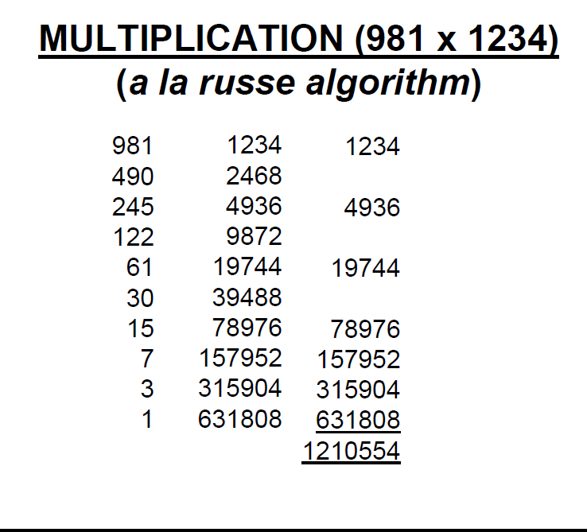
Multiplication
Analysis of Algorithm

Slide 32
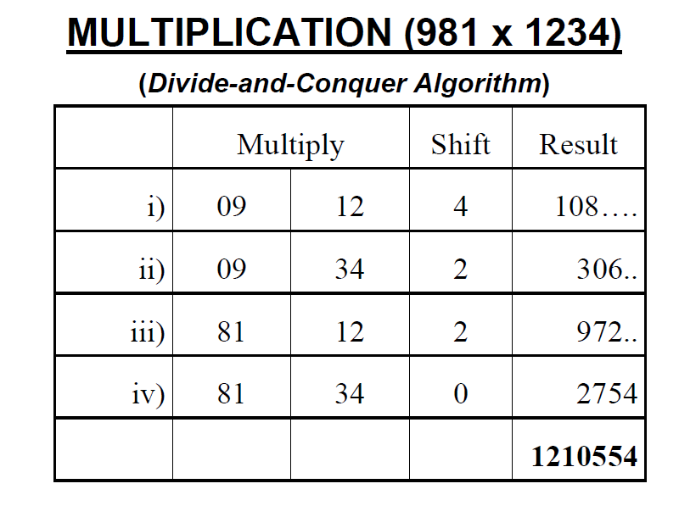
Multiplication
Analysis of Algorithm

Slide 33

The Selection Problem
Which algorithm is better?
Analysis of Algorithm

Slide 34
Which algorithm is better?
The algorithms are correct, but which is the best?
Measure the running time (number of operations needed).
Measure the amount of memory used.
Note that the running time of the algorithms increase as the size of the input increases.
Analysis of Algorithm

Slide 35
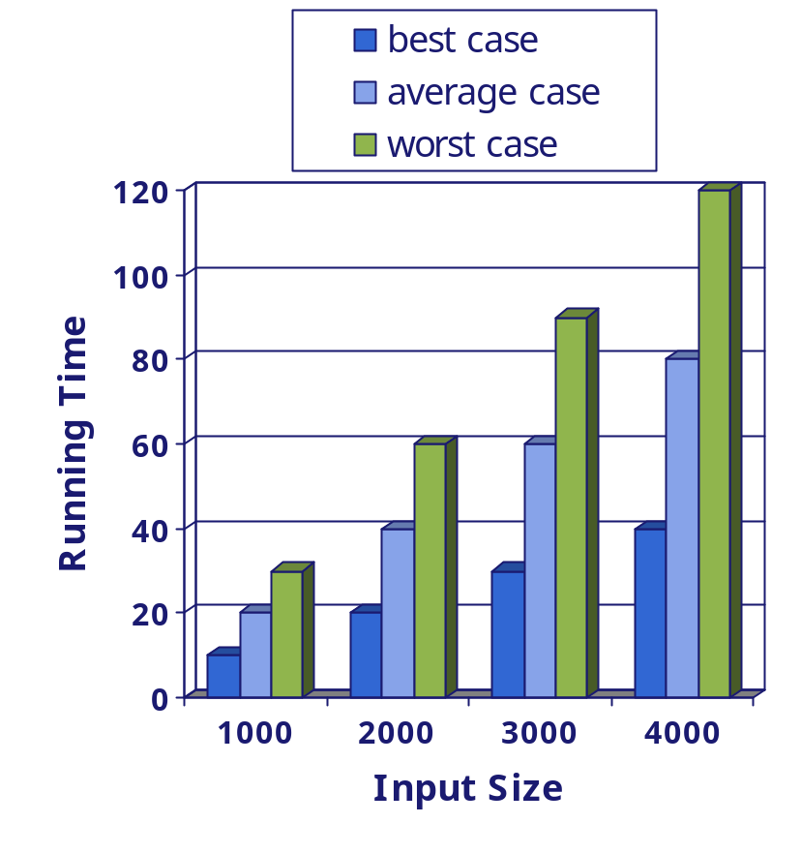
Running Time
Most algorithms transform input objects into output objects.
The running time of an algorithm typically grows with the input size.
Average case time is often difficult to determine.
We focus on the worst case running time.
  Easier to analyze
  Crucial to applications such as games, finance and robotics
Analysis of Algorithm

Slide 36
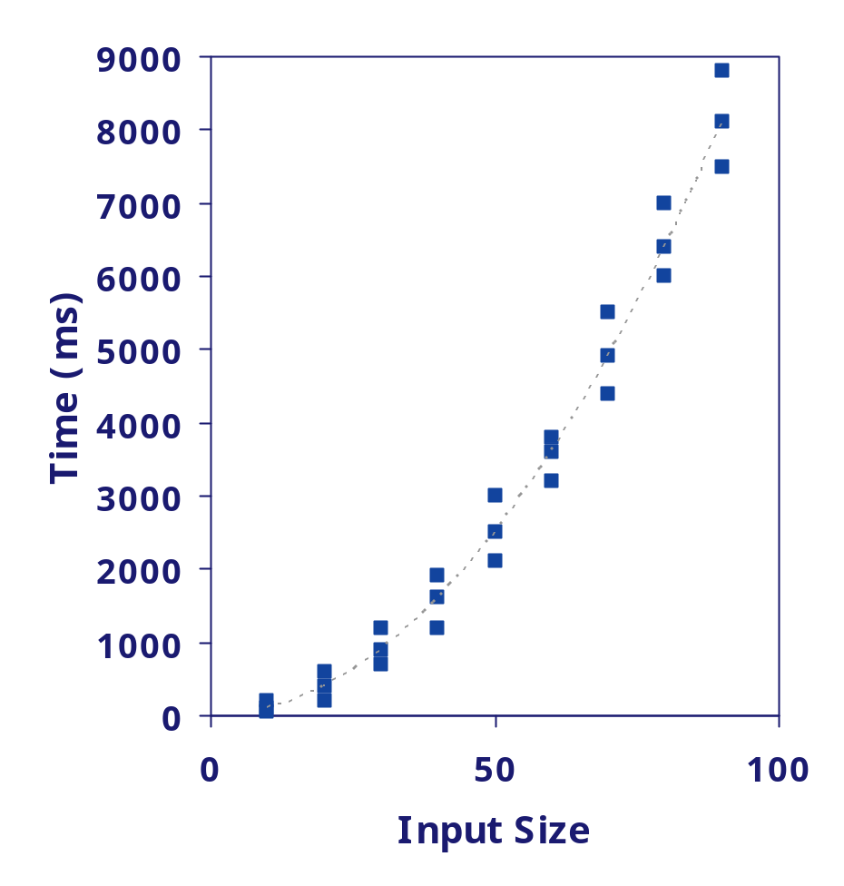
Experimental Studies
Write a program implementing the algorithm
Run the program with inputs of varying size and composition
Use a method like System.currentTimeMillis() to get an accurate measure of the actual running time
Plot the results
Analysis of Algorithm

Slide 37
Limitations of Experiments
It is necessary to implement the algorithm, which may be difficult
Results may not be indicative of the running time on other inputs not included in the experiment.
In order to compare two algorithms, the same hardware and software environments must be used
Analysis of Algorithm

Slide 38

Theoretical Analysis
Uses a high-level description of the algorithm instead of an implementation
Characterizes running time as a function of the input size, n.
Takes into account all possible inputs
Allows us to evaluate the speed of an algorithm independent of the hardware/software environment
Analysis of Algorithm

Slide 39

RAM model
has one processor
executes one instruction at a time
each instruction takes "unit time“
has fixed-size operands, and
has fixed size storage (RAM and disk).
Analysis of Algorithm

Slide 40
Counting Primitive Operations (§3.4)
By inspecting the pseudo code, we can determine the maximum number of primitive/basic operations executed by an algorithm, as a function of the input size
Algorithm arrayMax(A, n)
# operations
currentMax ← A[0] 2
for (i =1; i<n; i++) 2n
(i=1 once, i<n n times, i++ (n-1) times:post increment i.e 1+ n + n -1 = 2n )
if A[i] > currentMax then 2(n − 1)
currentMax ← A[i] 2(n − 1)
return currentMax 1
Total 6n −1
Analysis of Algorithm
Notes:
i<n last condition checking n times
i++ n-1 last time terminate at 2nd part

Slide 41

Estimating Running Time
Algorithm arrayMax executes 6n − 1 primitive operations in the worst case.
Define:
  a = Time taken by the fastest primitive operation
  b = Time taken by the slowest primitive operation
Let T(n) be worst-case time of arrayMax. Then
a (6n − 1) ≤ T(n) ≤ b(6n − 1 )
Hence, the running time T(n) is bounded by two linear functions
Analysis of Algorithm

Slide 42

Growth Rate of Running Time
Changing the hardware/ software environment
  Affects T(n) by a constant factor, but
  Does not alter the growth rate of T(n)
The linear growth rate of the running time T(n) is an essential property of algorithm arrayMax
Analysis of Algorithm

Slide 43
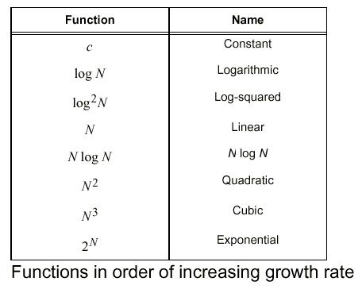
Function of Growth rate
Analysis of Algorithm

Slide 44
Big-Oh Notation
To simplify the running time estimation,
for a function f(n), we ignore the constants and lower order terms.
Example: 10n³+4n²-4n+5 is O(n³).
Analysis of Algorithm

Slide 45
Why ???
Why we are measuring the complexity of Algorithms ???.
Reason : Not only to design algorithms but to design efficient type of algorithms which can finish in finite amount of time.

Slide 46
Why asymptotic Notations
Asymptotic notation is a way to represent the time complexity
Design efficient algorithm terminate in finite amount of Time/ acceptable amount of time.
  Making use of Asymptotic notations for measuring running time of algorithm for large input size and measure its growth rate .

Slide 47
Input Size
Input size (number of elements in the input)
  size of an array
  polynomial degree
  # of elements in a matrix
  # of bits in the binary representation of the input
  vertices and edges in a graph

Slide 48
Efficiency Measurement
Efficiency relative term
Single algorithm : Polynomial Time Period
(Efficient)
Comparing Algorithms for finding their efficiencies
Notes:
In a polynomial function, the variable x is raised to some integer power.
f(x) = 5x³ + 8x⁵
g(x) = (x + 5)²
In an exponential function, some real number is raised to the power of variable x or some function of x
f(x) = 5ˣ
g(x) = eˣ⁺²

Slide 49
Types of Analysis
Worst case (at most BIG O)
  Provides an upper bound on running time
  An absolute guarantee that the algorithm would not run longer, no matter what the inputs are
Best case (at least Omega Ω )
  Provides a lower bound on running time
  Input is the one for which the algorithm runs the fastest
Average case (Theta Θ )
  Provides a prediction about the running time
  Assumes that the input is random

Slide 50
How do we compare algorithms?
We need to define a number of objective measures.
(1) Compare execution times?
Not good: times are specific to a particular computer !!
(2) Count the number of statements executed?
Not good: number of statements vary with the
programming language as well as the style of the individual programmer.

Slide 51
Ideal Solution
Express running time as a growth function of the input size n (i.e., f(n)).
Compare different functions corresponding to running times.
Such an analysis is independent of machine time, programming style, etc.

Slide 52
Asymptotic Analysis
To compare two algorithms with running times f(n) and g(n), we need a rough measure that characterizes how fast each function grows.
Hint: use rate of growth
Compare functions in the limit, that is, asymptotically!
  (i.e., for large values of n)
Notes:
The term asymptotic means approaching a value or curve arbitrarily closely (i.e., as some sort of limit is taken).

Slide 53
Asymptotic Notation
O notation :Big-O is the formal method of expressing the upper bound of an algorithm's running time.
It's a measure of the longest amount of time it could possibly take for the algorithm to complete.
Formally, for non-negative functions, f(n) and g(n), if there exists an integer n₀ and a constant c > 0 such that for all integers n > n₀, f(n) ≤ cg(n), then f(n) is Big O of g(n).

Slide 54
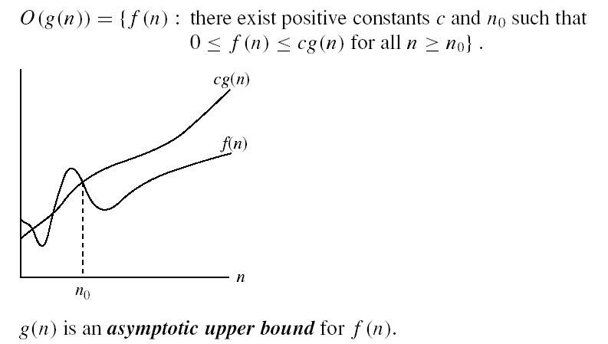
Asymptotic notations
O-notation

Slide 55
Asymptotic Notation
Big-Omega Notation Ω
This is almost the same definition as Big Oh, except that "f(n) ≥ cg(n)”
This makes g(n) a lower bound function, instead of an upper bound function.
It describes the best that can happen for a given data size.
For non-negative functions, f(n) and g(n), if there exists an integer n₀ and a constant c > 0 such that for all integers n > n₀, f(n) ≥ cg(n), then f(n) is omega of g(n). This is denoted as "f(n) = Ω(g(n))".

Slide 56
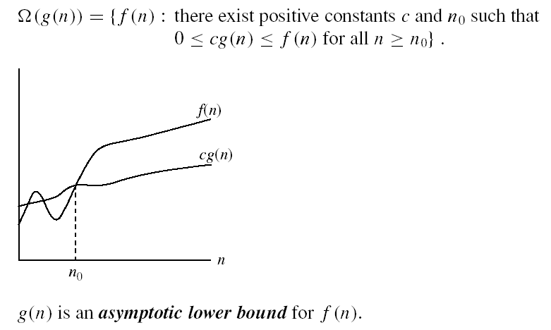
Asymptotic notations (cont.)
Ω - notation
Ω(g(n)) is the set of functions with larger or same order of growth as g(n)

Slide 57
Asymptotic Notation
Theta Notation Θ
Theta Notation For non-negative functions, f(n) and g(n), f(n) is theta of g(n) if and only if f(n) = O(g(n)) and f(n) = Ω(g(n)). This is denoted as "f(n) = Θ(g(n))".
This is basically saying that the function, f(n) is bounded both from the top and bottom by the same function, g(n).

Slide 58


Asymptotic notations (cont.)
Θ-notation
Θ(g(n)) is the set of functions with the same order of growth as g(n)

Slide 59
Asymptotic notations (cont.)
Little-O Notation
For non-negative functions, f(n) and g(n), f(n) is little o of g(n) if and only if f(n) = O(g(n)), but f(n) ≠ Θ(g(n)). This is denoted as "f(n) = o(g(n))".
This represents a loose bounding version of Big O. g(n) bounds from the top, but it does not bound the bottom.
Little Omega Notation
For non-negative functions, f(n) and g(n), f(n) is little omega of g(n) if and only if f(n) = Ω(g(n)), but f(n) ≠ Θ(g(n)). This is denoted as "f(n) = ω(g(n))".
It bounds from the bottom, but not from the top.

Slide 60
Example
Associate a "cost" with each statement.
Find the "total cost“ by finding the total number of times each statement is executed.
Algorithm 1 Algorithm 2
Cost Cost
arr[0] = 0; c₁ for(i=0; i<N; i++) c₂
arr[1] = 0; c₁ arr[i] = 0; c₁
arr[2] = 0; c₁
... ...
arr[N-1] = 0; c₁
----------- -------------
c₁+c₁+...+c₁ = c₁ x N (N+1) x c₂ + N x c₁ =
(c₂ + c₁) x N + c₂

Slide 61
Another Example
Algorithm 3 Cost
sum = 0; c₁
for(i=0; i<N; i++) c₂
for(j=0; j<N; j++) c₂
sum += arr[i][j]; c₃
------------
c₁ + c₂ x (N+1) + c₂ x N x (N+1) + c₃ x N²

Slide 62
Rate of Growth
Consider the example of buying elephants and goldfish:
Cost: cost_of_elephants + cost_of_goldfish
Cost ~ cost_of_elephants (approximation)
The low order terms in a function are relatively insignificant for large n
n⁴ + 100n² + 10n + 50 ~ n⁴
i.e., we say that n⁴ + 100n² + 10n + 50 and n⁴ have the same rate of growth

Slide 63
FURTHER DISCUSSION
NEXT WEEK …………….
Analysis of Algorithm

